Slide 1
Paleolithic Bones
By Marcus Dennehy

Slide 2
Summary and goal
Summary and Goal: This research exploration was done in my interest in ancient hominids, and early modern humans. The research article I chose, Everyday Life In the Ice Age by Elle Clifford and Paul Bahn delved into every aspect of Paleolithic life. This includes cave paintings, archaeological findings and more importantly, skeletal remains of those modern humans. The study specifically researches the upper paleolithic period, 40,000 to 12,000 Years ago. The article goes on to picture the life of the people at the time; every aspect of life from religious cave paintings and ritualistic burials to unique biological trauma and taphonomies. What the article has done is compile archaeological, bio-anthropological and ethnographic material evidence in order to paint the fullest picture of Ice Age life. More importantly, this includes studies of specific osteological remains from dig sites. These early modern human sites can also shed some insight into how people died, the cause of death and the bone trauma of the person. Consequently, identifying these taphonomies, we can widen our perspective on the daily existential struggles of an upper Paleolithic human. In order to try to understand the lives of these ancient peoples, we must be able to analyze taphonomic and osteological processes to visualize their existence.

Slide 3
The Forgotten Us-Initiating Research
Research warrented for examining Ice Age Peoples bones.
Ice Age Peoples had same behavioural, biological, and intellectual capabilities as humans today.
Important to address how humans survived in early communities before civilization.
Show how physically different our lives were and how they impacted certain bones.

Slide 4
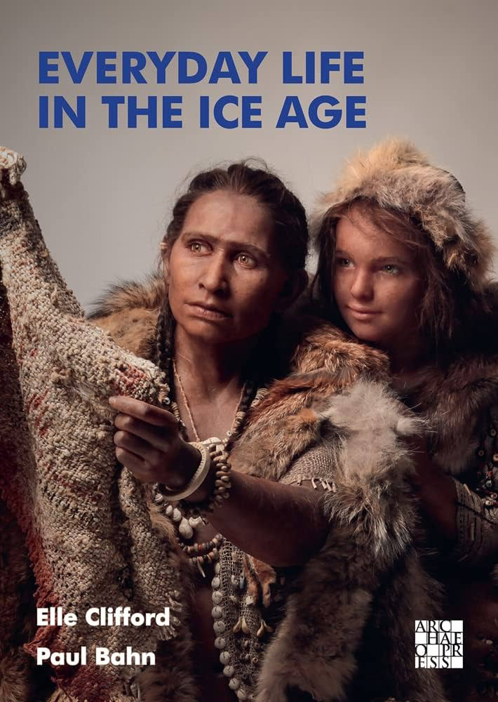
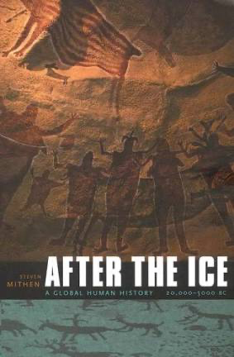
Previous Studies
Everyday Life In The Ice Age
Published 2022
First collective study of its kind published in English
Written by Elle Clifford & Paul Bahn
Focuses 40,000 to 12,000 years ago
After the Ice: A Global Human History by Steven Mithen (2003)
20,000 to 5,000 BC
Most previous studies focused more on hyper specific case studies.

Slide 5
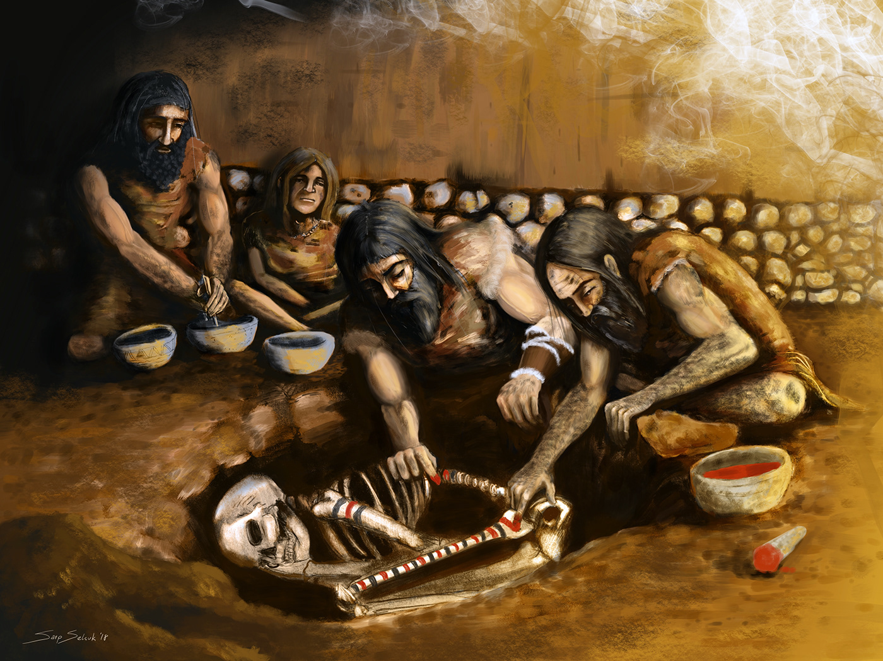
Osteological Techniques
Taphonomic/Pathology
Preservation: Qualitative and quantitative
Sex estimation
Age estimation
Epiphyseal fusion
Trauma analysis
Burial practices
Age of death peri mortem

Slide 6
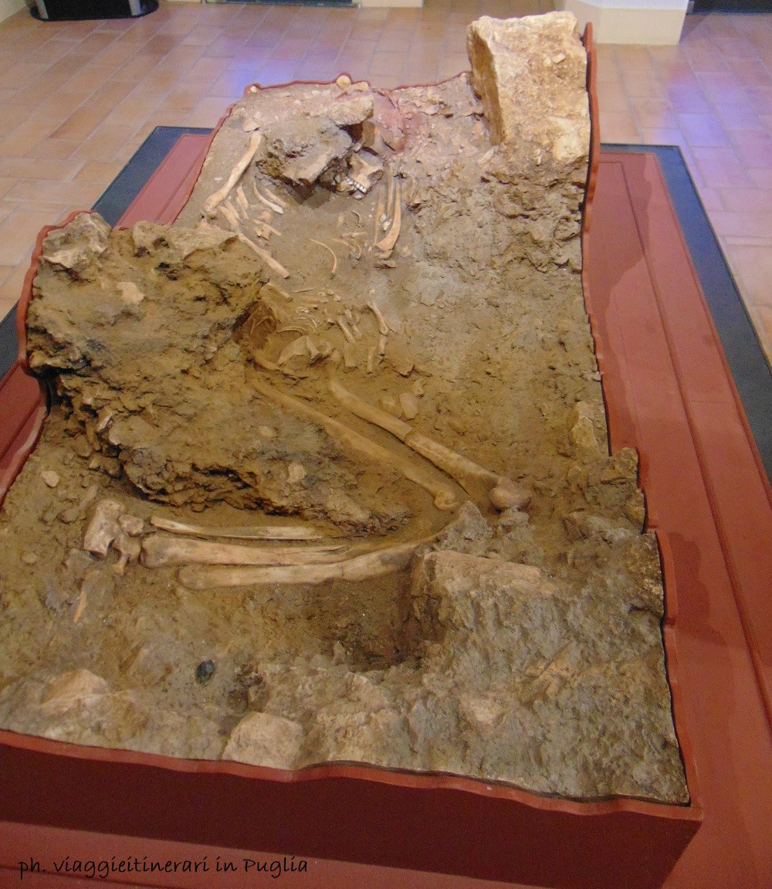
Ostuni Burial of Santa Maria di Agnano

Slide 7
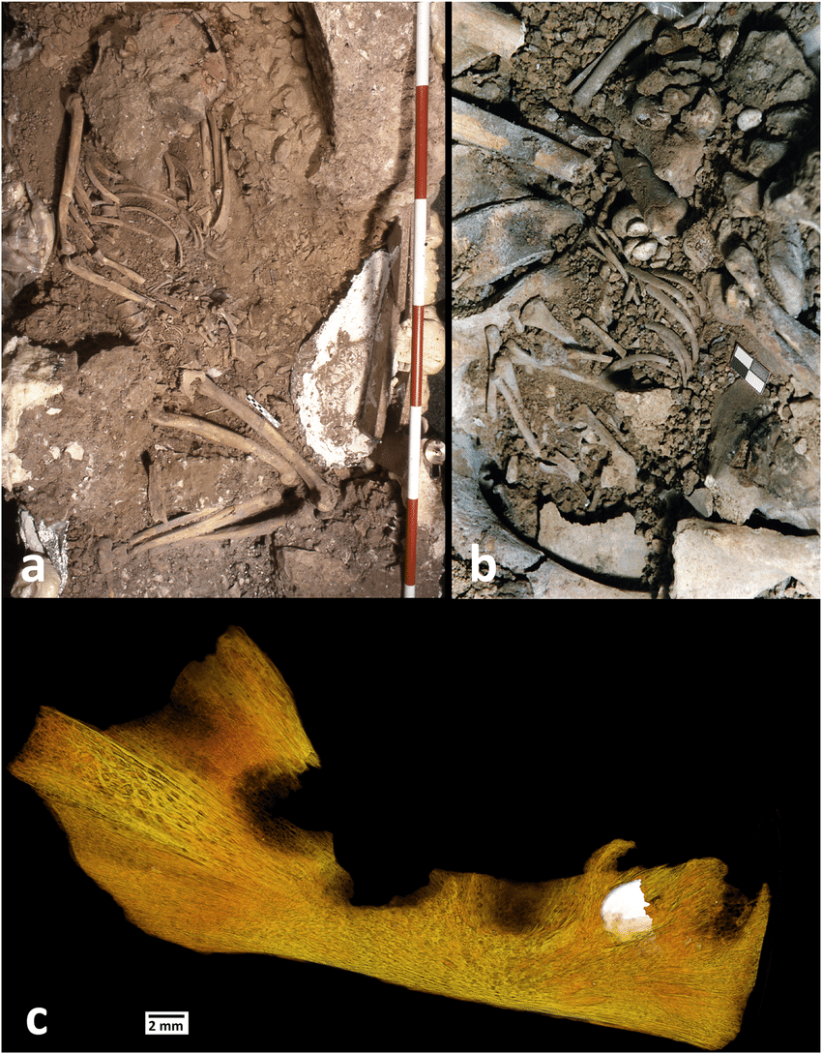
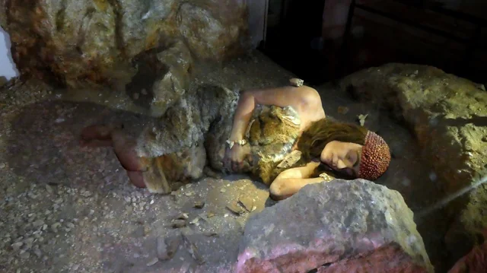
Analysis
Remains of young women and her foetal remains in advanced stages of pregnancy.
Carbon dated 27,000 years ago
Estimated that the women died at 31-33 gestational weeks.
Remains of fetus are well preserved in the pelvic bone region.
Bones indicate the women was healthy and fit peri mortem.
Women located in flexed position
Unknown death

Slide 8
Theories and Obstacles
Dental stress episodes may led to perimortem death of both
The lower right lateral deciduous incisor (LRi2) is visible through the bone transparency. On the left mandible
Lack of other findings
Other external stressors may have affected pregnancy (Eg. fight in the tribe, or lack of food/resources).
Microbiol Erosion: Gut bacteria post-mortem that breaks down Infant and younger skeletons, leaving little behind
Due to many factors:
Epiphysis not fully ossified
Weak bones compared to adults
Exposure to erosion, decomposition
Position of skeleton helped preserve woman body, but not as much as Infants.

Slide 9
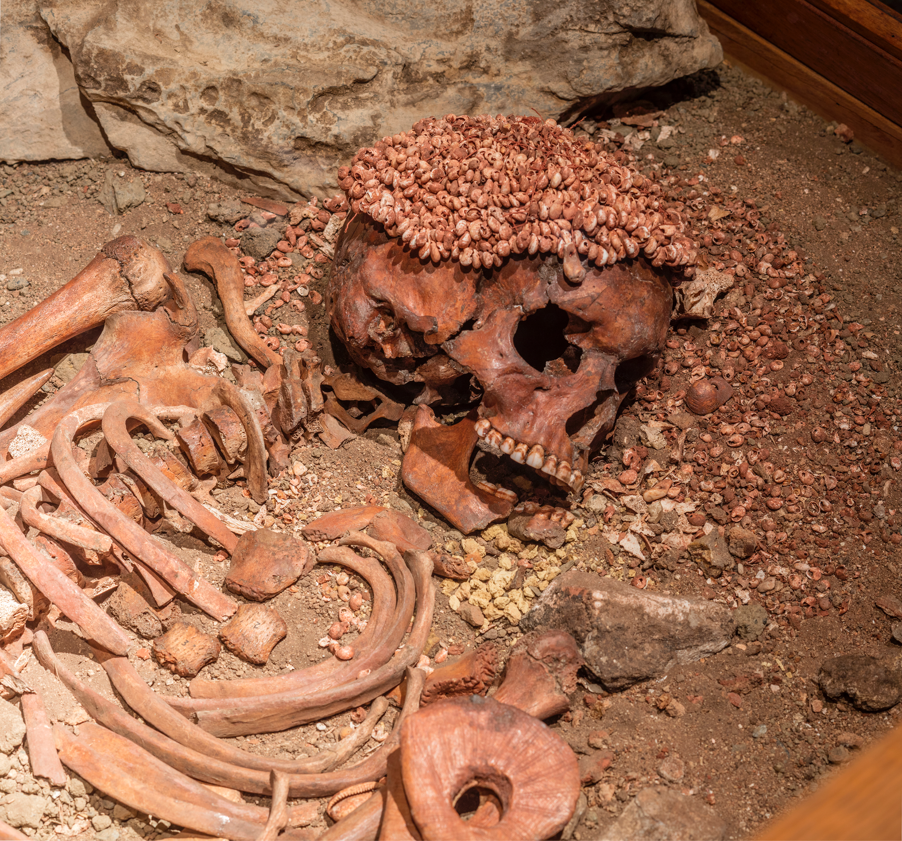
Il Principe
Discovered in 1941 in the Arene Candide in Monte Caprazoppa, Liguria, Italy.
A mass burial site
20 individuals: both sexes, from young to old.
Il Principe: 15-18 year old adolescent male.
Carbon dated 23,000 years ago.
Adorned with Paleolithic jewelry and covered in red ochre.
Right part of mandible is missing, filled in with yellow ochre.

Slide 10
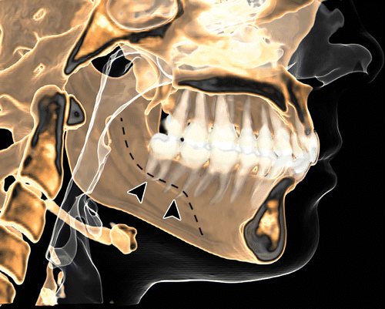
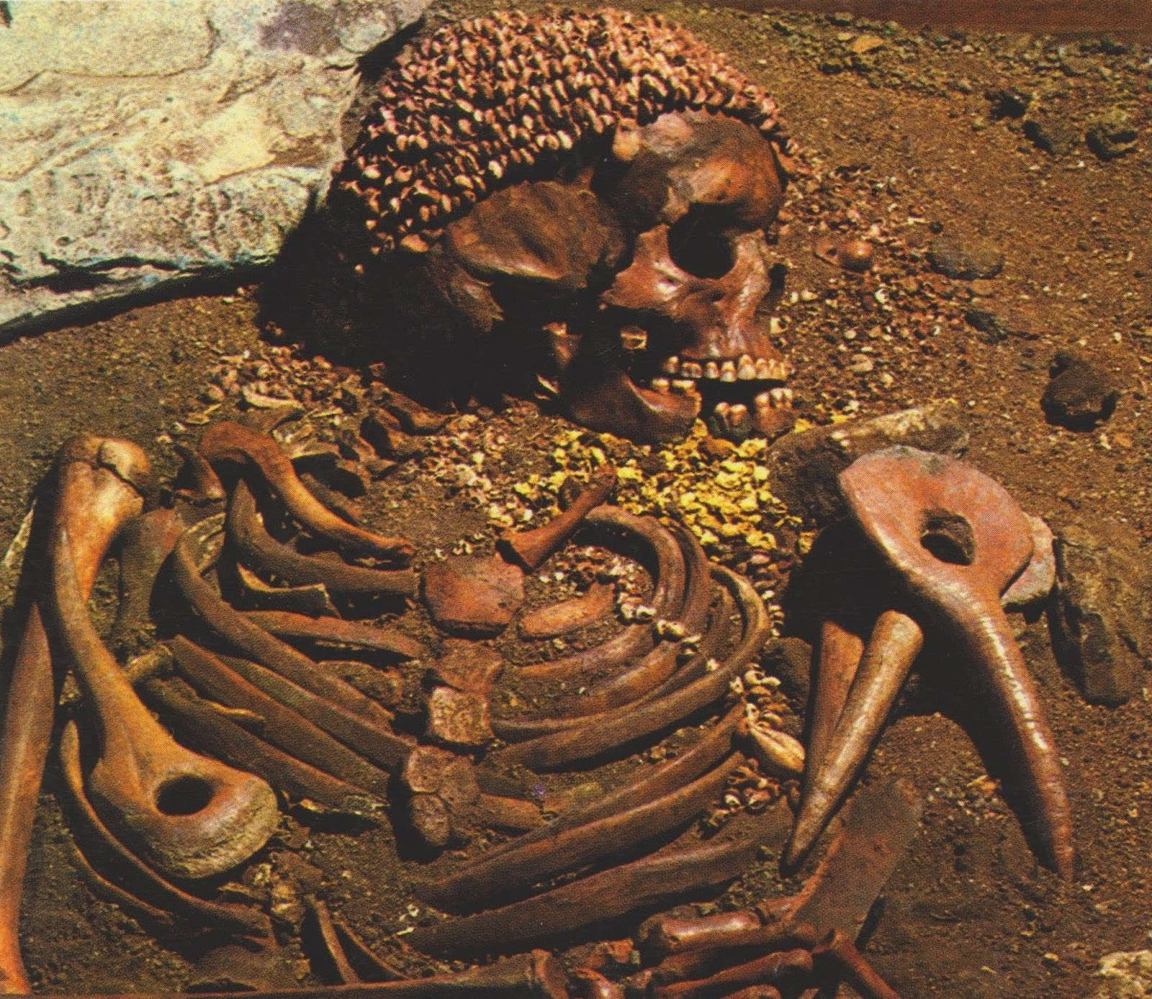
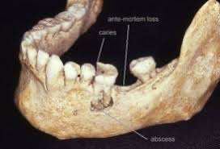
Taphonomic analysis
Cause of death may have been a tooth abscess
Developed over time without treatment
Tooth abscess can lead to tooth decay and leave a pocket of puss either inside the tooth, gums or bone.
Mandible suggests the tooth abscess infected the bloodstream, traveling to his head and internal organs.

Slide 11
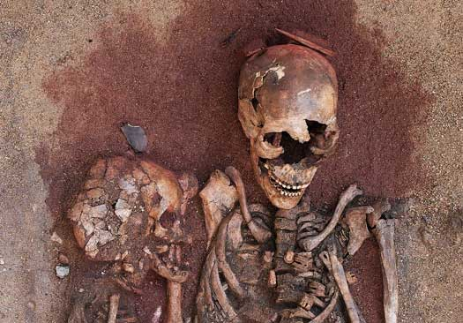
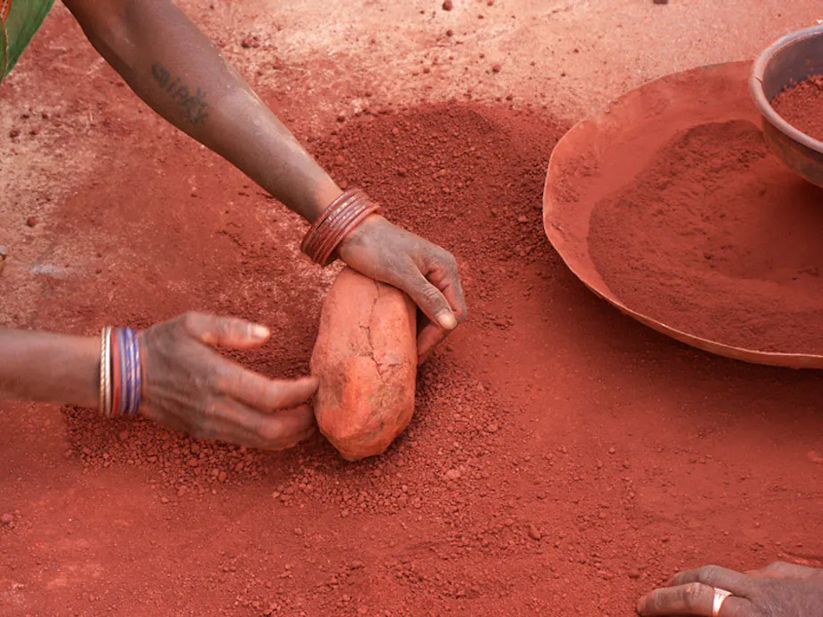
Burial practices-Use of Ochre on Skeletal Remains
Use of Red ochre on skeletal remains for religious burial practices.
Suggests spiritual and practical uses.
Means of marking a burial cite to avoid digging.
Different colored Ochre used symbolically on Il Principes body.
Yellow ochre was more rare in Upper Paleolithic times.

Slide 12
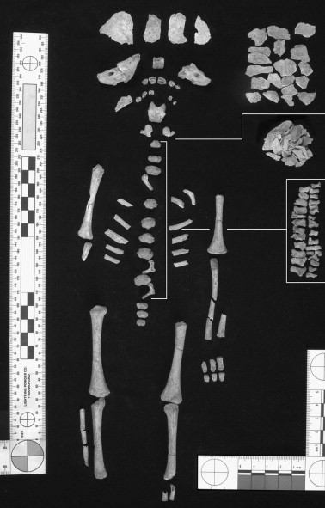
Perinatal Skeleton of Wilczyce, Poland
Hill site excavation in 2000
Found many butchered animal bones
Flint figurines indicated a hunting site.
Dated 13,000 YA
Mistakes in research indicated further analysis of site.
Research in 2005 by Bodil Bratlund finds infant remains.
Infant skeleton 60% complete.
Perinatal remains date back to 38 weeks peri-mortem
Osteometric determined period of death through dental formation findings.

Slide 13
Conclusion
These three skeletal remains from the article show a variety of techniques that were employed in order to find the cause of death. These taphonomic processes were reliable, but as some research shows, takes a lot of methodical analysis to get the full perspective.
Comparable with the conclusions met with these skeletal remians, it is safe to say that the techniques were relatively successful in achieving valuable study. As we march to the future, we learn more and more about our past each day, which keeps us rooted in the present.

Slide 14
Works cited
Clifford, E., & Bahn, P. (2022). Ice Age People: From Womb to Tomb. In Everyday Life in the Ice Age: A New Study of Our Ancestors (pp. 159–202). Archaeopress. https://doi.org/10.2307/j.ctv2tjd6m7.10

Slide 15
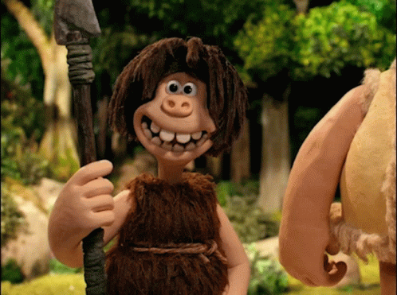
Thank you!!

